Slide 1
CREDIT EDA CASE STUDY
BY Amaresh DUTTA & DHANUSH

Slide 2
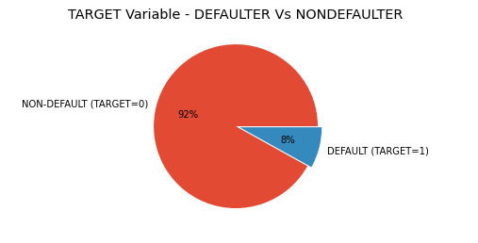
TARGET VARIABLE – DEFAULTER VS NON-DEFAULTER
Its clear that there is an imbalance between people who defaulted and who didn't default.
More than 92% of people didn't default as opposed to 8% who defaulted.

Slide 3
Univariate Analysis

Slide 4
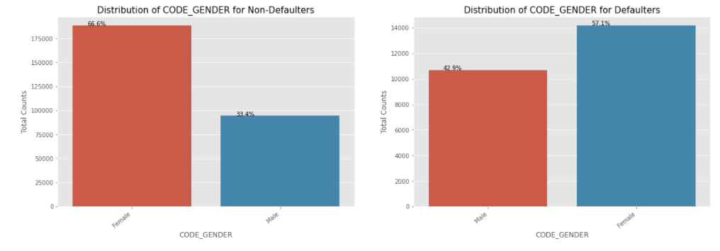
DISTRIBUTION OF CODE_GENDER for non-defaulters and defaulters
We can see that Female contribute 67% to the non-defaulters while 57% to the defaulters.
We can conclude that We see more female applying for loans than males and hence the more number of female defaulters as well.
But the rate of defaulting of FEMALE is much lower compared to their MALE counterparts.

Slide 5
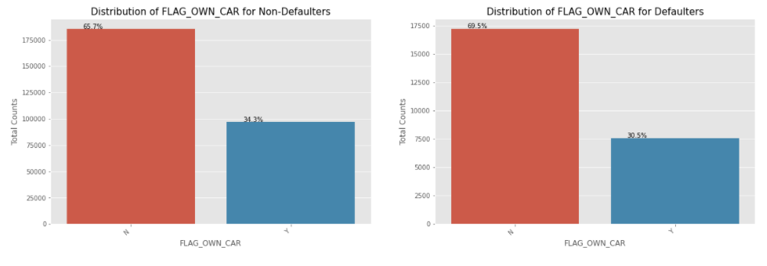
DISTRIBUTION OF flag_own_car for non-defaulters and defaulters
We can see that people with cars contribute 65.7% to the non-defaulters while 69.5% to the defaulters.
We can conclude that While people who have car default more often, the reason could be there are simply more people without cars Looking at the percentages in both the charts, we can conclude that the rate of default of people having car is low compared to people who don't.

Slide 6
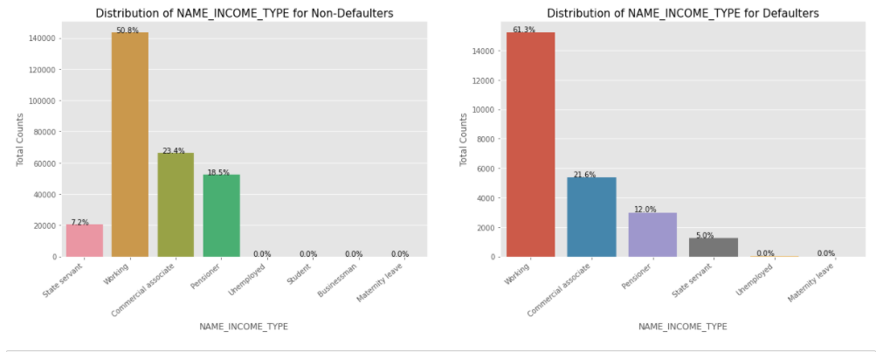
DISTRIBUTION OF name_income_type for non-defaulters and defaulters
We can notice that the students don't default. The reason could be they are not required to pay during the time they are students.
We can also see that the Businessmen never default.
Most of the loans are distributed to working class people
We also see that working class people contribute 51% to non defaulters while they contribute to 61% of the defaulters. Clearly, the chances of defaulting are more in their case.

Slide 7
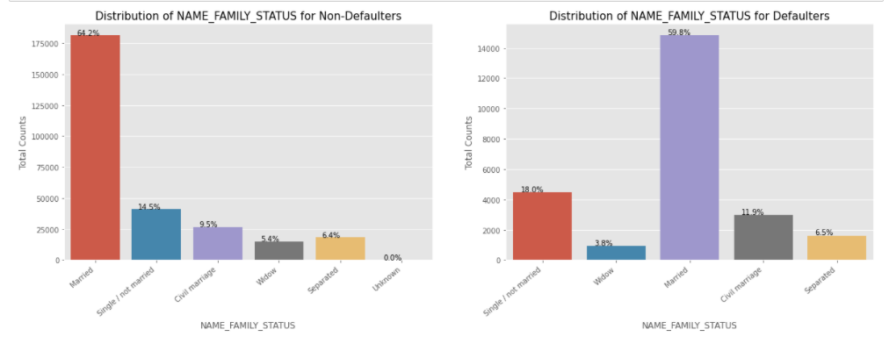
DISTRIBUTION OF name_family_status for non-defaulters and defaulters
Married people tend to apply for more loans comparatively.
But from the graph we see that Single/non Married people contribute 14.5% to Non Defaulters and 18% to the defaulters. So there is more risk associated with them.

Slide 8
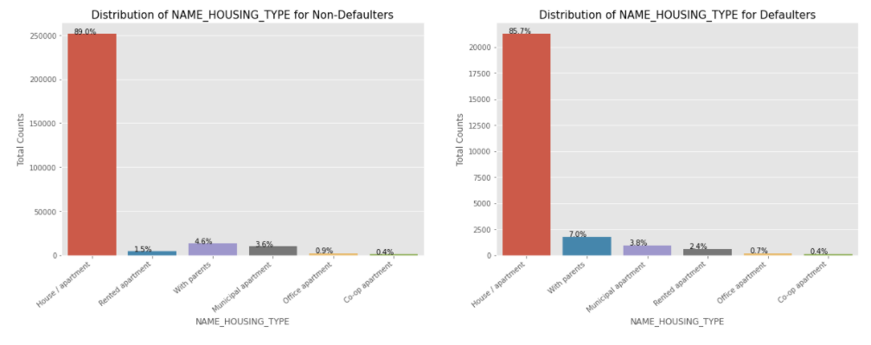
DISTRIBUTION OF NAME_HOUSING_TYPE FOR non-defaulters and defaulters
It is clear from the graph that people who have House/Apartment, tend to apply for more loans.
People living with parents tend to default more often when compared with others. The reason could be their living expenses are more due to their parents living with them.

Slide 9
Univariate Categorical Ordered Analysis

Slide 10
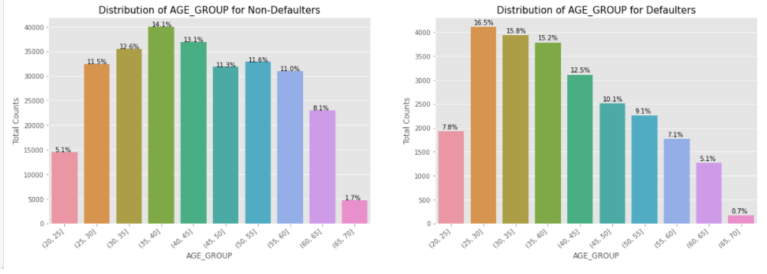
DISTRIBUTION OF AGE_GROUP FOR non-defaulters and defaulters
We see that (25,30] age group tend to default more often. So they are the riskiest people to loan to.
With increasing age group, people tend to default less starting from the age 25.
One of the reasons could be they get employed around that age and with increasing age, their salary also increases.

Slide 11
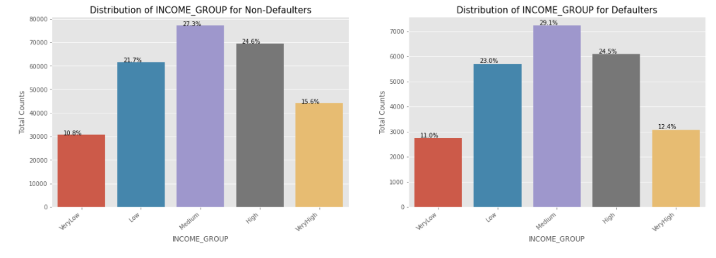
DISTRIBUTION OF INCOME_GROUP FOR non-defaulters and defaulters
The Very High income group tend to default less often. They contribute 12.4% to the total number of defaulters, while they contribute 15.6% to the Non-Defaulters.

Slide 12
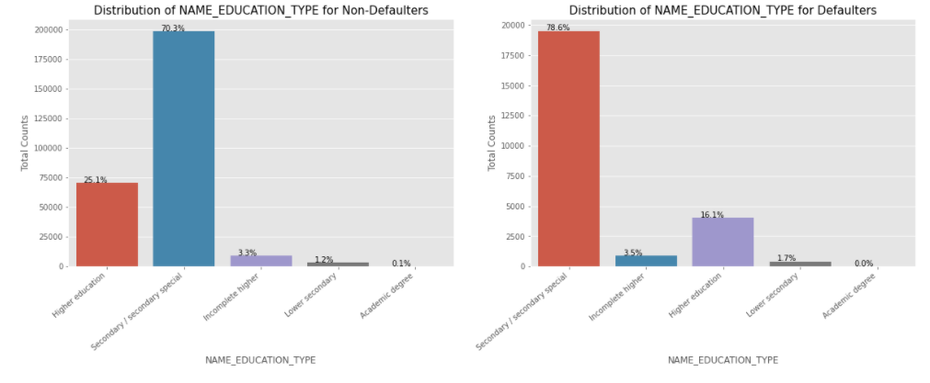
DISTRIBUTION OF NAME_EDUCATION_TYPE FOR non-defaulters and defaulters
Almost all of the Education categories are equally likely to default except for the higher educated ones who are less likely to default and secondary educated people are more likely to default

Slide 13
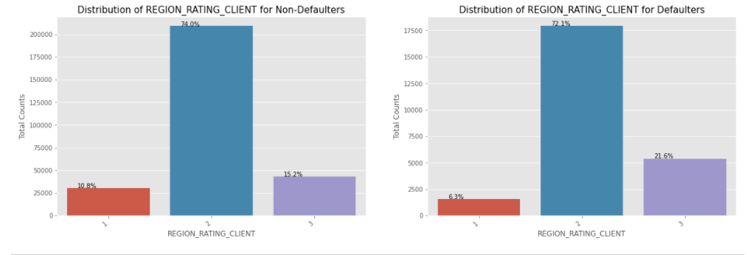
DISTRIBUTION OF REGION_RATING_CLIENT FOR non-defaulters and defaulters
More people from second tier regions tend to apply for loans.
We can infer that people living in better areas(Rating 3) tend contribute more to the defaulters by their weightage.
People living in 1 rated areas

Slide 14
Univariate continuous variable analysis

Slide 15
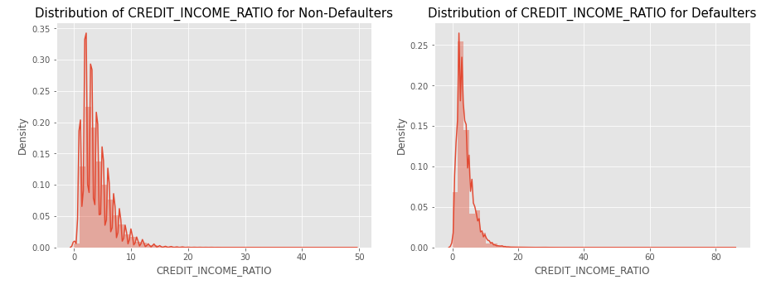
DISTRIBUTION OF CREDIT_INCOME_RATIO FOR non-defaulters and defaulters
Credit income ratio the ratio of AMT_CREDIT/AMT_INCOME_TOTAL.
Although there doesn't seem to be a clear distinguish between the group which defaulted vs the group which didn't when compared using the ratio, we can see that when the CREDIT_INCOME_RATIO is more than 50, people default.

Slide 16
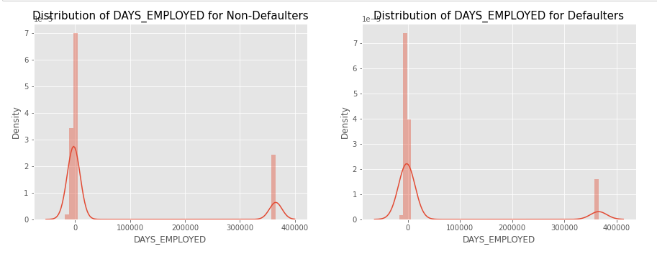
DISTRIBUTION OF days_employed FOR non-defaulters and defaulters
It is evident that tenured employee falls more on non-defaulters category and was better repaying compared to less tenured employee

Slide 17
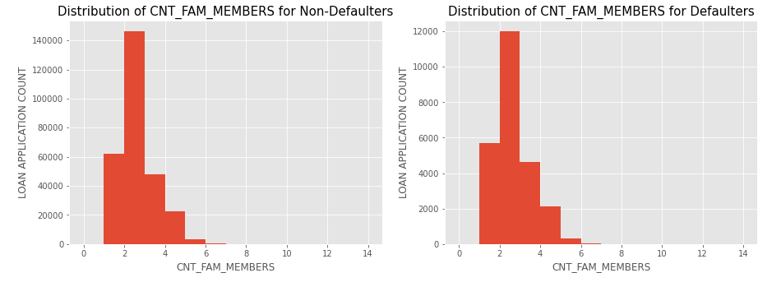
DISTRIBUTION OF CNT_FAM_MEMBERS FOR non-defaulters and defaulters
The graph shows that CNT_FAM_MEMBERS non-defaulters had higher loan application count when compared to defaulters

Slide 18
Bivariate Analysis of numerical variables

Slide 19
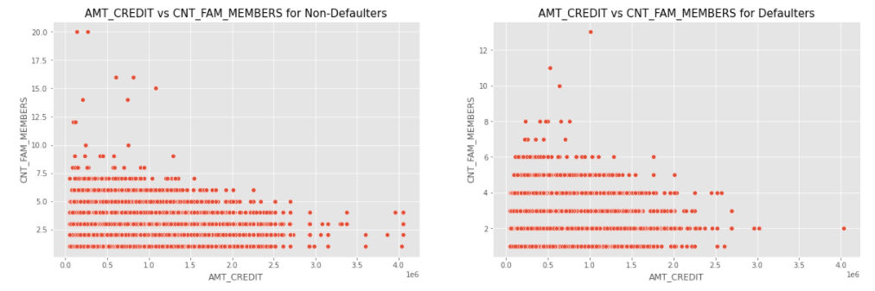
DISTRIBUTION OF AMT_CREDIT VS CNT_FAM_MEMBERS FOR non-defaulters and defaulters
We can see that the density in the lower left corner is similar in both the case, so the people are equally likely to default if the family is small and the AMT_CREDIT is low.
We can observe that larger families and people with larger AMT_CREDIT default less often

Slide 20
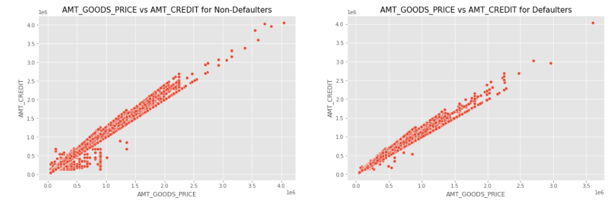
DISTRIBUTION OF AMT_GOODS_PRICE VS AMT_CREDIT FOR non-defaulters and defaulters

Slide 21
Data Analysis For Previous Application Data (UNIVARIATE ANALYSIS)

Slide 22
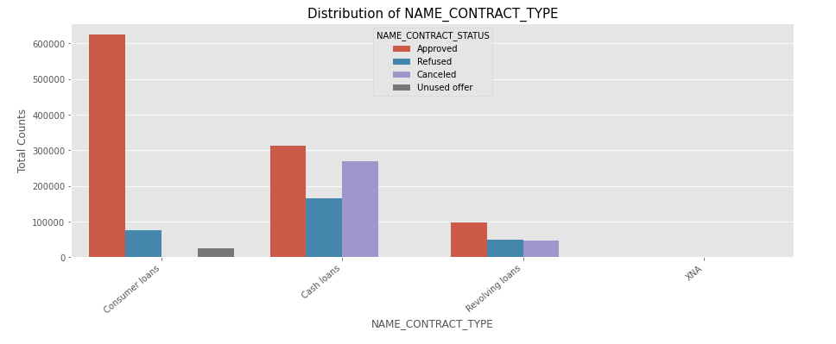
DISTRIBUTION OF NAME_CONTRACT_TYPE
From the chart, we can infer that, most of the applications are for 'Cash loan' and 'Consumer loan'. Although the cash loans are refused more often than others.

Slide 23
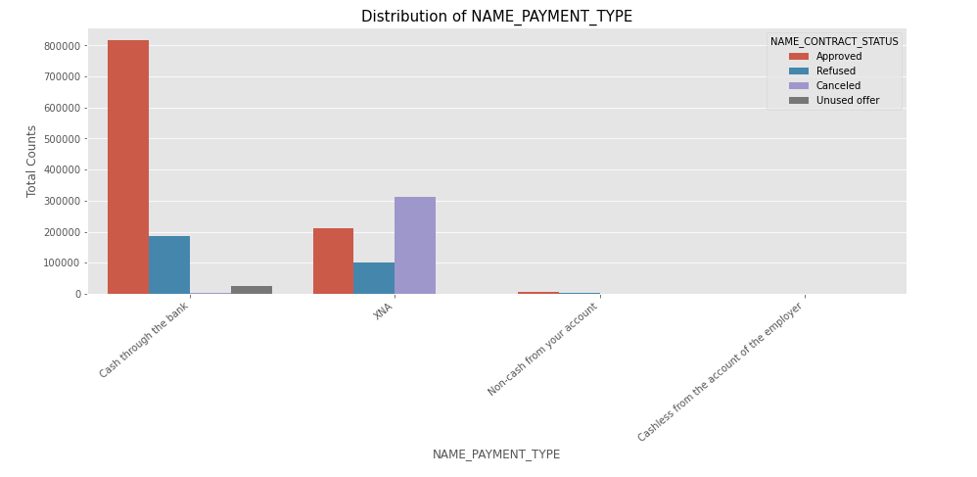
DISTRIBUTION OF NAME_PAYMENT_TYPE
From the chart, we can infer that most of the clients chose to repay the loan using the 'Cash through the bank' option
We can also see that 'Non-Cash from your account' & 'Cashless from the account of the employee' options are not at all popular in terms of loan repayment amongst the customers.

Slide 24
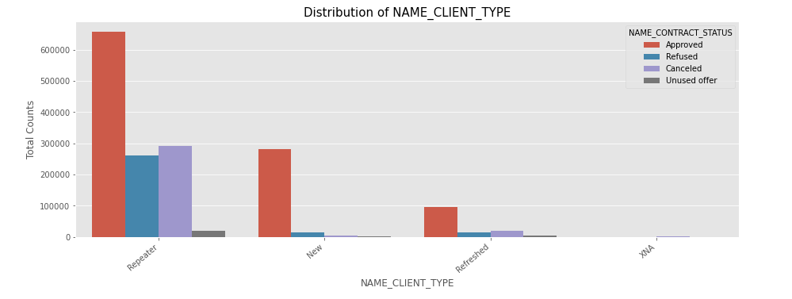
DISTRIBUTION OF NAME_CLIENT_TYPE
Most of the loan applications are from repeat customers, out of the total applications 70% of customers are repeaters. They also get refused most often.

Slide 25
Pair plot to perform bivariate analysis on numerical columns

Slide 26
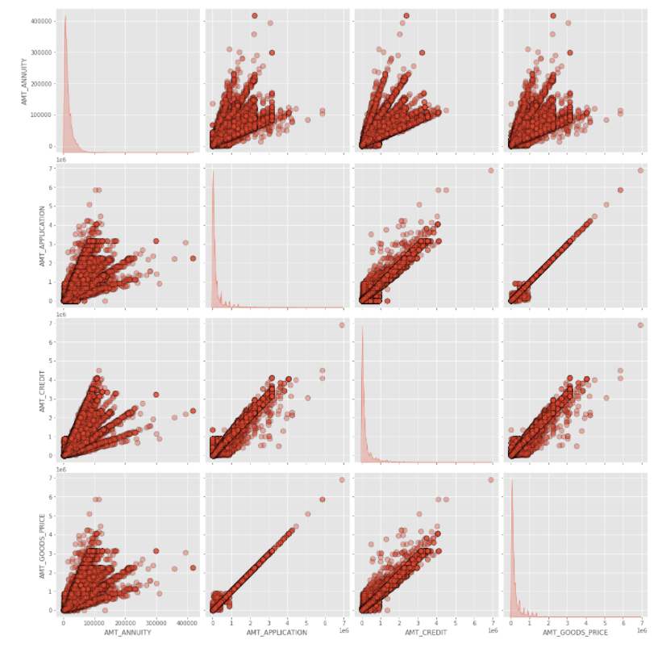
Annuity of previous application has a very high and positive influence over: (Increase of annuity increases below factors)
(1) How much credit did client asked on the previous application
(2)Final credit amount on the previous application that was approved by the bank
(3) Goods price of good that client asked for on the previous application.
For how much credit did client ask on the previous application is highly influenced by the Goods price of good that client has asked for on the previous application
Final credit amount disbursed to the customer previously, after approval is highly influence by the application amount and also the goods price of good that client asked for on the previous application.

Slide 27
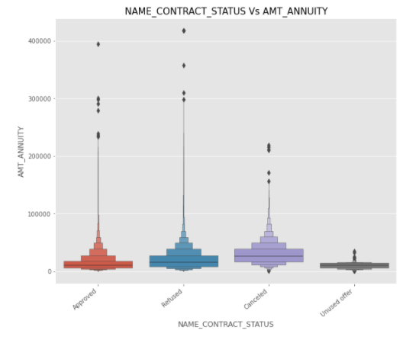
DISTRIBUTION OF NAME_CONTRACT_STATUS VS AMT_ANNUITY
From the above plot we can see that loan application for people with lower AMT_ANNUITY gets canceled or Unused most of the time.
We also see that applications with too high AMT ANNUITY also got refused more often than others.

Slide 28
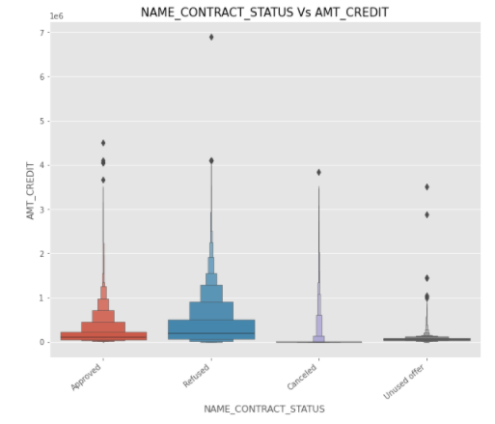
DISTRIBUTION OF NAME_CONTRACT_STATUS VS AMT_CREDIT
We can infer that when the AMT_CREDIT is too low, it get's cancelled/unused most of the time.

Slide 29
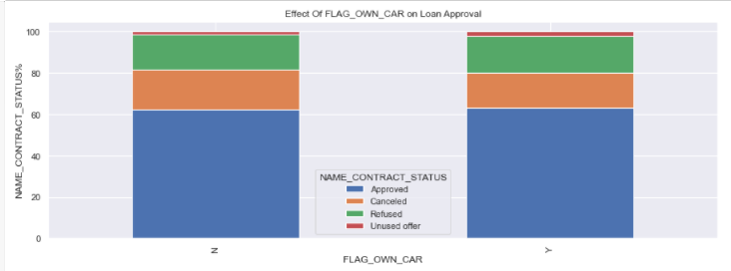
EFFECT OF FLAG_OWN_CAR ON LOAN APPROVAL
We see that car ownership doesn't have any effect on application approval or rejection. But we saw earlier that the people who has a car has lesser chances of default. The bank can add more weightage to car ownership while approving a loan amount

Slide 30
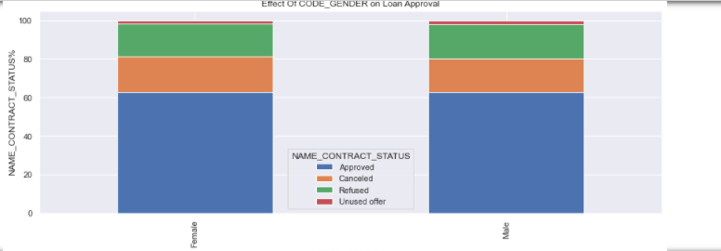
EFFECT OF CODE_GENDER ON LOAN APPROVAL
We see that code gender doesn't have any effect on application approval or rejection.
But we saw earlier that female have lesser chances of default compared to males. The bank can add more weightage to female while approving a loan amount.

Slide 31
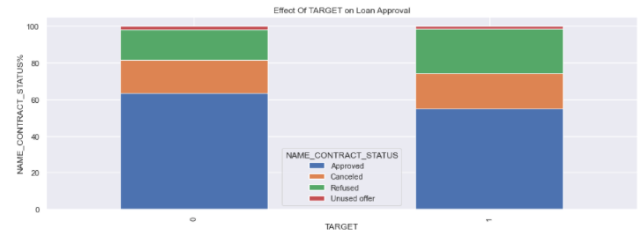
EFFECT OF TARGET ON LOAN APPROVAL
We can see that the people who were approved for a loan earlier, defaulted less often where as people who were refused a loan earlier have higher chances of defaulting.
Target variable (0 - Non Defaulter 1 - Defaulter )

Slide 32
CONCLUSION
The category of students, working people and businessmen non-defaulters are more compared to other type of professionals so if banks concentrates more on these categories repayment of loans will be easier.
Banks should fix a income limit to sanction loan because the person with less income most likely are ending up in defaulters list.
The bank can add more weightage to female while approving a loan amount based on the study.
The people who were approved for a loan earlier, defaulted less often where as people who were refused a loan earlier have higher chances of defaulting.
Married person repays better than single/divorced/unmarried
People who are greater than Age 25 default less because as they settle in job around that age hence the salary also increased in accordance with Job, age, and professional growth
Since most of the amount are paid in the form of “ONLINE TRANSACATIONS” it is advised while sanctioning loan bank needs to check the bank balance account history before crediting the loan.

